Slide 1
MEDICAL SHOP MANAGEMENT SYSTEM

Slide 2
TABLE DESIGN TABLE NAME:ADMIN
FIELD | DATA TYPE | SIZE | CONSTRAINT
admin id | Int | 10 | Primary key
First name | Varchar | 20 | Not null
Last name | Varchar | 20 | Not null
Email | Varchar | 20 | Not null
Phone | Int | 10 | Not null
Password | Varchar | 20 | Not null

Slide 3
TABLE NAME:MANAGER
FIELD | DATA TYPE | SIZE | CONSTRAINT
Manager id | Int | 10 | Primary key
First name | Varchar | 20 | Not null
Last name | Varchar | 20 | Not null
Phone | Int | 10 | Not null
username | Varchar | 20 | Not null
Password | Varchar | 20 | Not null

Slide 4
TABLE NAME:CASHIER
FIELD | DATA TYPE | SIZE | CONSTRAINT
cashier id | Int | 10 | Primary key
First name | Varchar | 20 | Not null
Last name | Varchar | 20 | Not null
Phone | Int | 10 | Not null
Username | Varchar | 20 | Not null
Password | Varchar | 20 | Not null

Slide 5
TABLE NAME:MEDICINE
FIELD | DATA TYPE | SIZE | CONSTRAINT
medicine id | Int | 10 | Primary key
Medicine brand | Varchar | 20 | Not null
Medicine name | Varchar | 20 | Not null
Expiry date | Date | 10 | Not null
Cost | Int | 5 | Not null
MG | Int | 5 | Not null

Slide 6
TABLE NAME:BILLING
FIELD | DATA TYPE | SIZE | CONSTRAINT
Billing id | Int | 10 | Primary key
Customer name | Varchar | 20 | Not null
Mobile number | Int | 10 | Not null
Medicine name | Varchar | 20 | Not null
MG | Varchar | 20 | Not null
Expiry date | Date | 10 | Not null
Total amount | Int | 10 | Not null

Slide 7
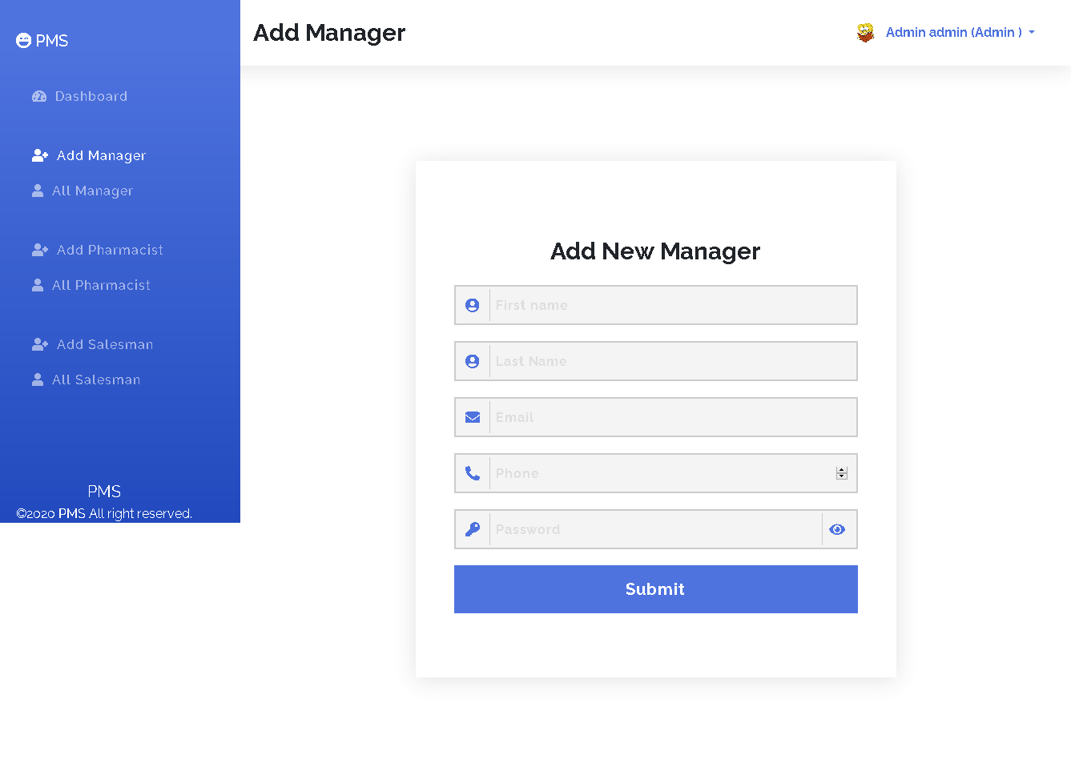

Slide 8
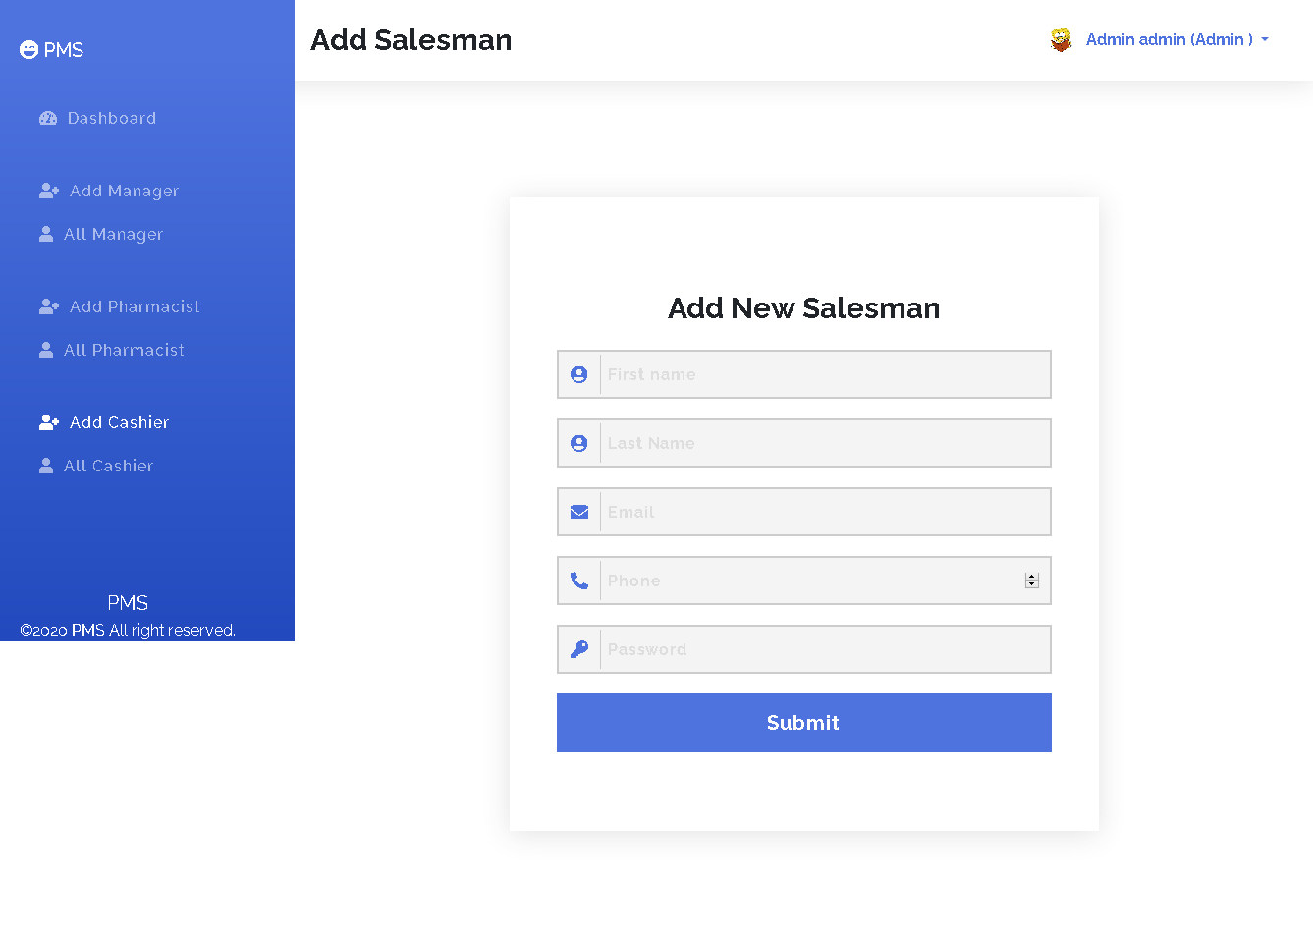

Slide 9


Slide 10
Thank You

